Slide 1





@BENOUALI ABDELKADER
" Quora Knowledge Hub"

Slide 2







Summary
01
Summary
07
Features of Quora
02
Quora ?
08
Video For You
03
Team Members
09
Quora Users By Country
04
Type of Tool
10
Knowledge is power
05
11
From the stone to the rocket
Famous Personalities on Quora
06
The purpose of Quora
12
Our sources
12
13
Message from an enemy
Message to us

Slide 3




Quora ?
Quora ?
Quora is a question-and-answer platform where users can ask questions on any topic and receive answers from other users, including subject matter experts and enthusiasts. It operates as a web-based platform and mobile app, allowing individuals to share knowledge, experiences, and insights in response to questions posed by the community.

Slide 4

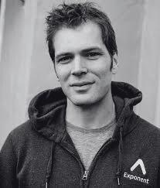


Team Members
Adam D'Angelo
Charlie Cheever
Co-founder and CEO
Co-founder and former CTO

Slide 5

Type of Tool
Type of Tool
Quora is a web-based platform and also has mobile apps (iOS and Android). It functions as a question-and-answer site where users contribute knowledge and insights on various topics.

Slide 6

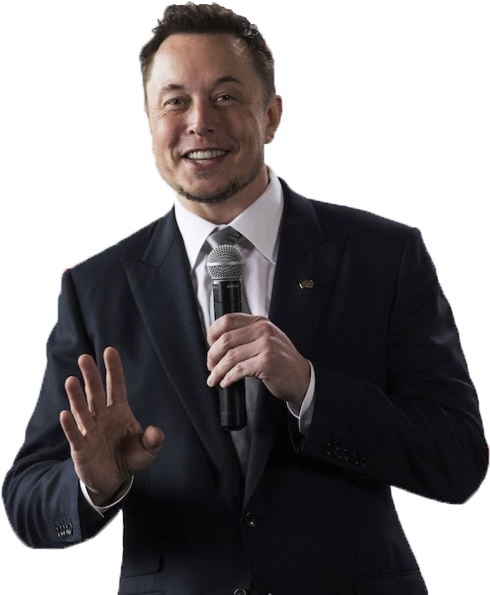


Famous Personalities on Quora
Many famous individuals and experts use Quora to share their knowledge and insights. Here are some notable people known for their presence on the platform:
Bill Gates
Neil deGrasse Tyson
Elon Musk
Co-founder of Microsoft
Astrophysicist and science communicator
CEO of SpaceX and Tesla

Slide 7

The purpose of Quora
Community Engagement
Knowledge Sharing
Expert Insights
01
02
03
Quora allows users to ask questions and provide answers on a wide range of topics, facilitating the exchange of information and insights.
The platform encourages interaction among users, allowing them to engage in discussions, share experiences, and connect with others who have similar interests.
Quora provides a space for experts and enthusiasts to share their knowledge, helping users access reliable information and diverse perspectives on various subjects.

Slide 8












Features of Quora
Question and Answer Format
Commenting and Discussions
Voting System
Stats and Analytics
Following Topics and People
Notifications
Spaces
Mobile Accessibility
Profile Pages
Language Support

Slide 9


Video For You
Knowledge is the key to progress
Quora

Slide 10
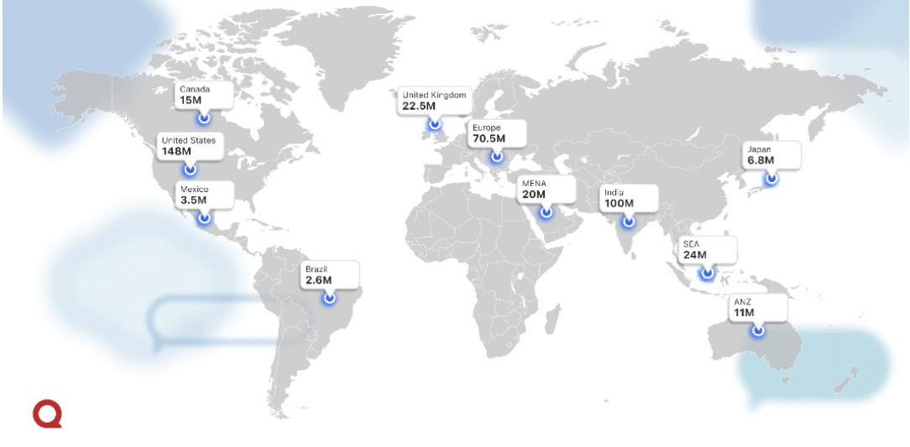
Quora Users By Country
With 148 million users, the United States has the most number of Quora users. Second on the list is India, with 100 million users.
In addition to the United States and India, Quora has a notable user base in other countries, such as the United Kingdom, with 22.5 million users, and Canada, with 15 million users.

Slide 11
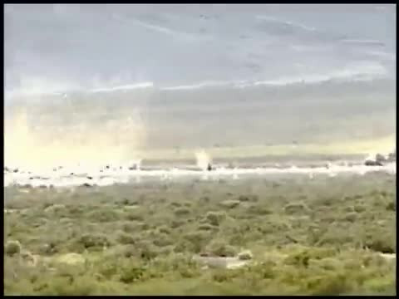
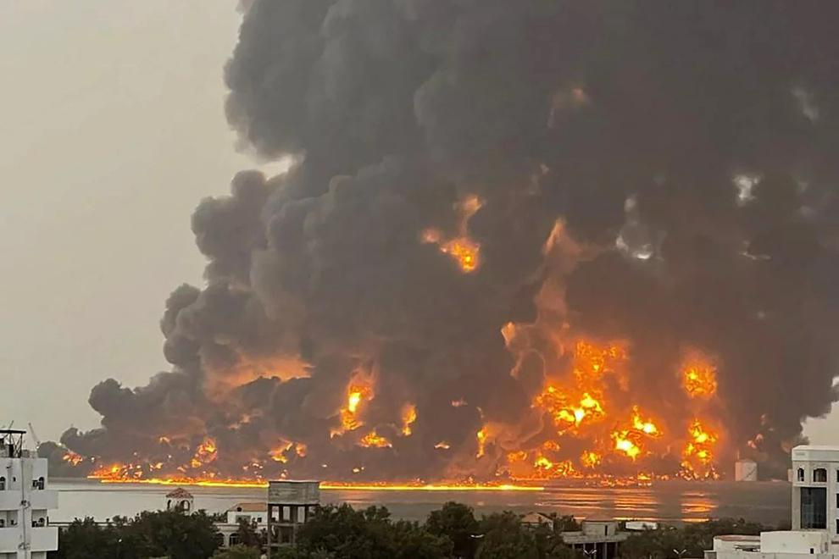
knowledge is essential
On July 20, 2024, the Israeli occupation launched its first airstrikes on Yemen, specifically targeting the port of Hodeidah. The aircraft flew more than 1,800 kilometers, crossing the Red Sea. The Israeli Defense Minister declared that their military influence extends across the Middle East, supported by advanced defense systems such as the Iron Dome, David’s Sling, THAAD, and hypersonic missiles. He stressed that Israel’s dominance is rooted in decades of investment in science, technology, and artificial intelligence, sending a clear message that acquiring knowledge is essential to national deterrence, not just a luxury. Knowledge is power in the hands of its owner, even if he is a criminal.

Slide 12
Knowledge is power
On July 20, 2024, the Israeli occupation launched its first airstrikes on Yemen, specifically targeting the port of Hodeidah. The aircraft flew more than 1,800 kilometers, crossing the Red Sea. The Israeli Defense Minister declared that their military influence extends across the Middle East, supported by advanced defense systems such as the Iron Dome, David’s Sling, THAAD, and hypersonic missiles. He stressed that Israel’s dominance is rooted in decades of investment in science, technology, and artificial intelligence, sending a clear message that acquiring knowledge is essential to national deterrence, not just a luxury. Knowledge is power in the hands of its owner, even if he is a criminal.

Slide 13
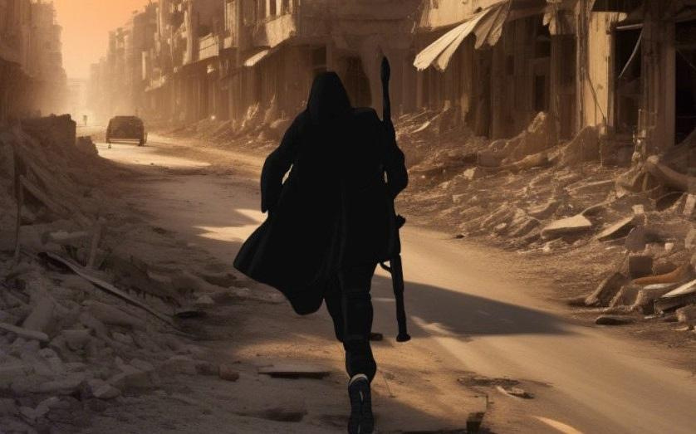
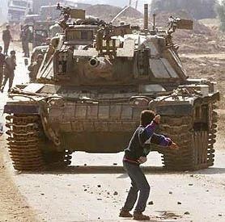


From the stone to the rocket
Knowledge is acquired even in the most difficult circumstances, as evidenced by the development of Palestinian resistance in Gaza, which has been under siege for 17 years, where 80% of the population lives below the poverty line and unemployment stands at 57%. Despite these challenges, Palestinians have been able to produce knowledge and technology, as Fares Odeh did, using stones against tanks and then developing missiles in 2024. Knowledge is thus a force that can bring about change even in the most difficult times.
Gaza
2024/01/29
Gaza
2000/10/29

Slide 14

Message from an enemy
Do you know me now? Let me tell you who I am:
I am your enemy, the one you despise.
I brought you down from ruling the world to defeat, took Andalusia and Palestine, and divided you into scattered nations.
I made you fight your brother who shares your faith, origin, and language.
I stripped you of knowledge, turned Baghdad into ruins, and own universities you struggle to enter.
I wield B-52 bombers, F-16s, and nuclear power, and I produce the movies you admire.
My elections decide your fate for years, and my citizen’s whims can shape your destiny.
Even the screen you’re reading this on? I invented it.
And to be honest, nothing in your room truly belongs to you.
Now that you've heard all this, tell me who you are?
“
I own knowledge. I own the world
“

Slide 15
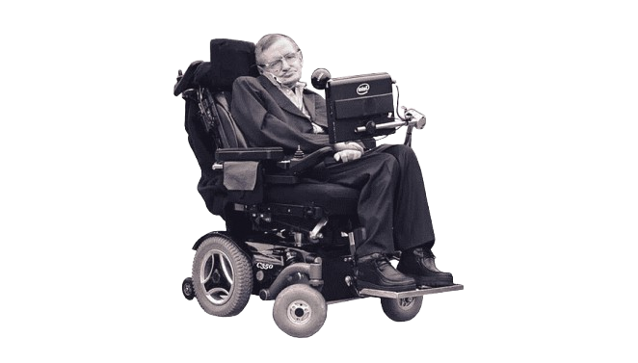
Message to us
"The greatest enemy of knowledge is not ignorance, it is the illusion of knowledge." Stephen Hawking
1942-2018

Slide 16





Our sources
We strive to offer the best, and that's why we rely on the best sources worldwide.

Slide 17




"Thank you for watching our presentation."
2024

